Slide 1





«بسم‌ الرحمن الرحیم»
Introduction to
Professor:
By:
Date:
Department:
Dr. Foshati
Atefeh Ghandehari
Feb 2025
Computer Engineering
(1)

Slide 2

Time-Sensitive Networking (TSN)
Enhances the capabilities of standard Ethernet networks by providing deterministic performance and real-time capabilities.
(2)

Slide 3
The Rise of Industrial Ethernet and the Need for TSN
The Shift Towards Ethernet
Challenges of Traditional Ethernet
Several advantages over traditional fieldbus technologies, including:
Lacks the real-time capabilities
jitter
cost-effectiveness
latency
ease of deployment
unpredictable network behavior
wide availability of devices
(3)

Slide 4
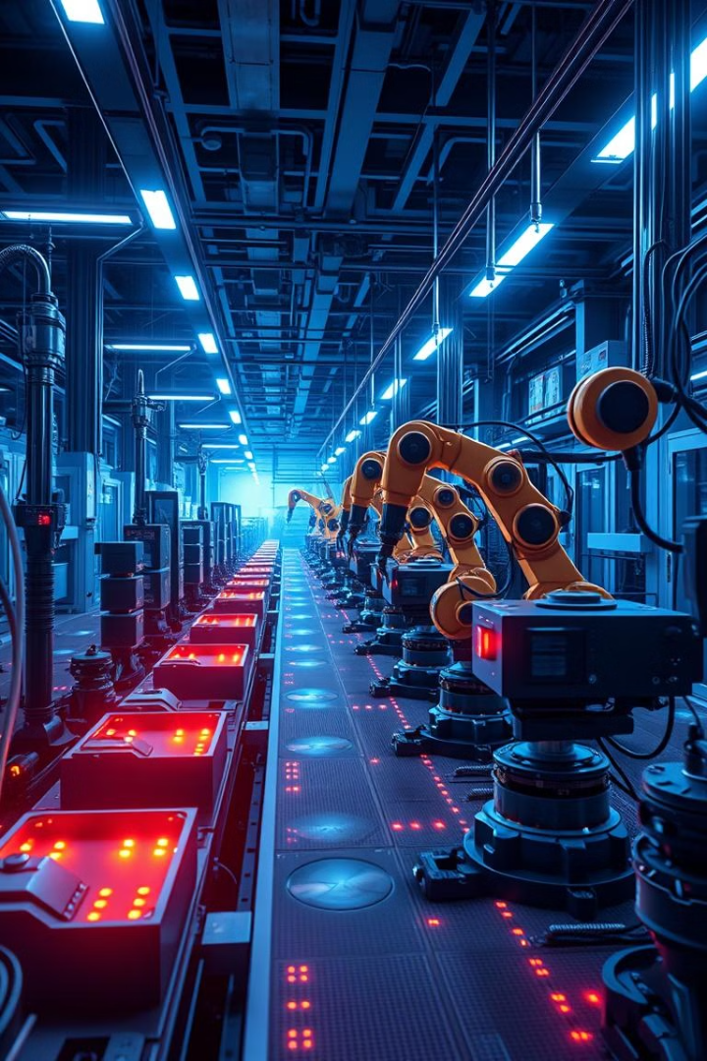
Key Features and Benefits of TSN
1
Deterministic Communication
2
Real-Time Capabilities
3
Improved Efficiency and Reliability
4
Enhanced Interoperability
(4)

Slide 5
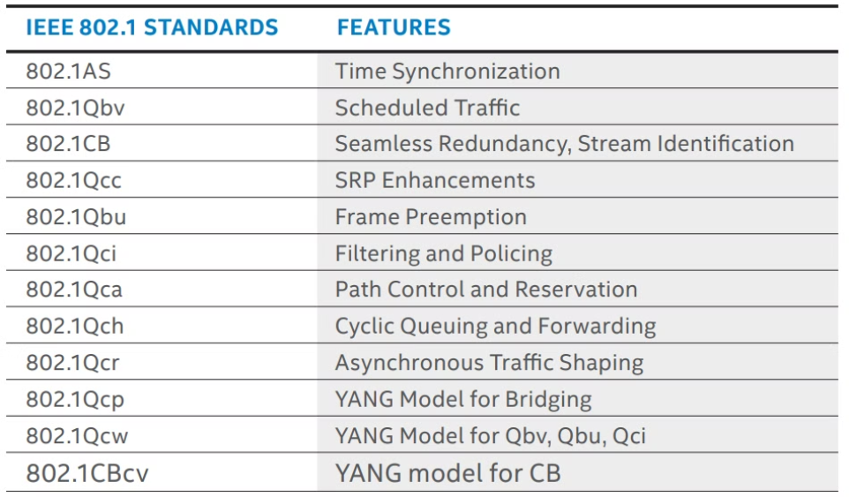
The features are defined and published in a number of IEEE 802.1
timing
synchronization
forwarding
queuing
seamless redundancy
stream reservation
(5)

Slide 6
TSN Standards and Protocols
IEEE 802.1Qbv
IEEE 802.1Qcc
IEEE 802.1Qci
IEEE 802.1CB
Time-Aware Shaper (TAS)
synchronization
network traffic classes
fault-tolerant
scheduling of time-critical traffic
prioritizing real-time
(6)

Slide 7
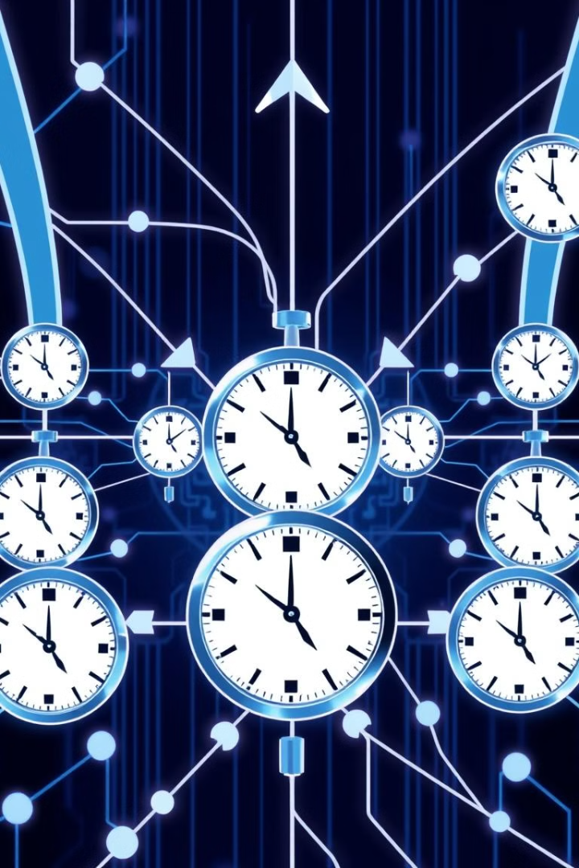



Timing and Synchronization in TSN
Precision Time Protocol (PTP)
Synchronize clocks
All devices operate in alignment
Master clock-Slave clocks
Time-Aware Shaper (TAS)
Schedules Time-Critical Traffic
Synchronization Mechanisms
Nanosecond-level accuracy
(7)

Slide 8
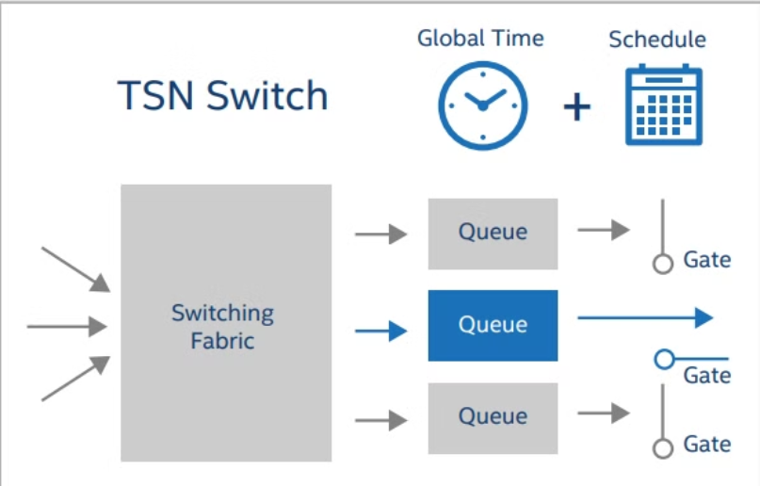
Traffic Scheduling
Multiple queues per port
until a gate opens → at a time slot specified
Scheduled Message Forwarding in TSN As Defined in the IEEE 802.1AS and 802.1Qbv Ethernet Standards
(8)

Slide 9

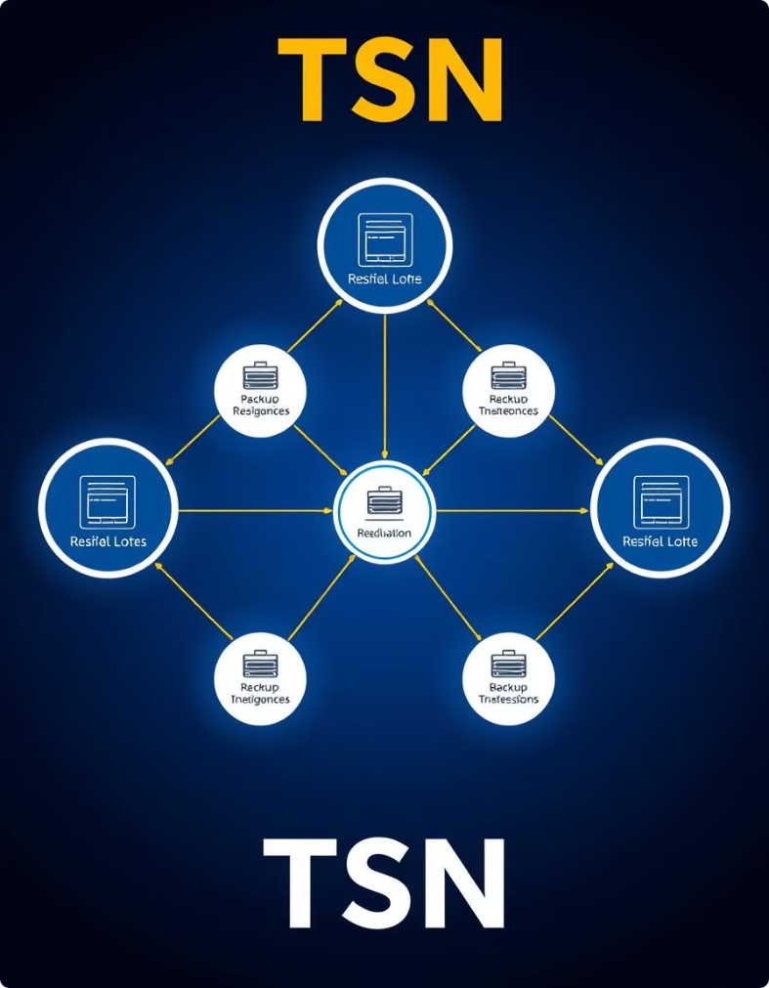



Redundancy and Fault Tolerance in TSN
Redundant Paths
Fast Failover Mechanisms
Network Resilience
(9)

Slide 10



Real-World TSN Applications and Use Cases
Robotics and Automation
Motion Control
Process Automation
(10)

Slide 11
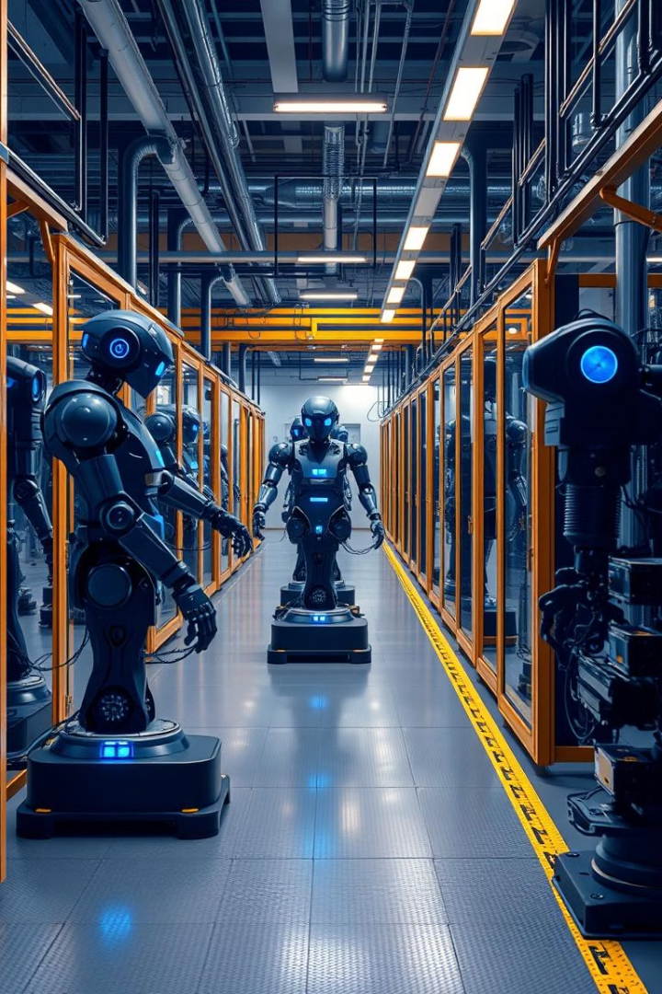
The Future of TSN and Industrial Automation
1
2
Increased Adoption
Enhanced Security
3
Edge Computing Integration
(11)

Slide 12

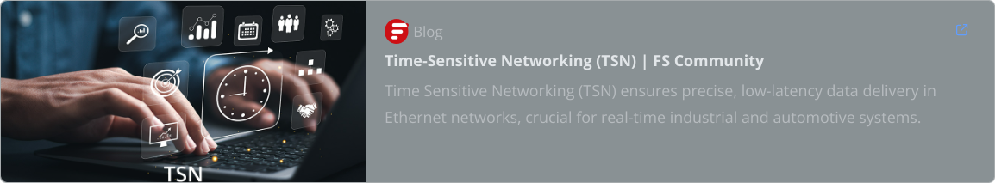

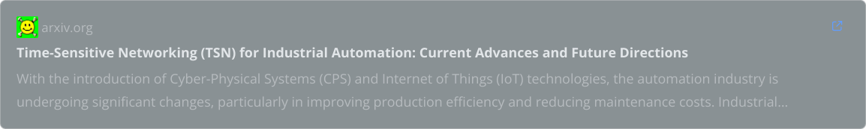
Recourses
https://cdrdv2-public.intel.com/752516/wp-01279-time-sensitive-networking-theory-to-implementation-in-industrial-automation.pdf

Slide 13
Thank you.

